Slide 1
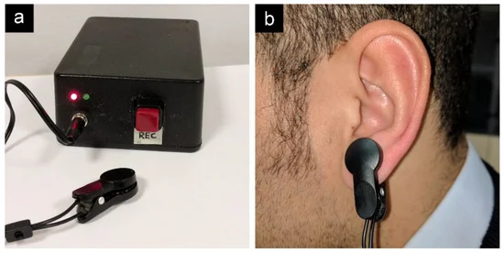
Earlobe-Mounted Integrated Monitoring System for Early Sepsis Detection
A.D.U.DEWMINI
D/ENG/23/0160/BM

Slide 2

ISSUE
Sepsis-related deaths remain high due to delayed detection.
Late detection leads to severe complications and long-term health issues
Many existing sepsis detection devices require invasive methods, causing discomfort and increased risk of infection.
Current devices often do not provide continuous monitoring, leading to missed early warning signs.
Existing devices are often bulky and uncomfortable for continuous wear.
Many devices have complex interfaces that are difficult for patients and non-specialist healthcare providers.

Slide 3

AIM
To design a compact, non-invasive medical device for early detection of sepsis conditions, integrating a pulse oximeter and temperature sensor on the earlobe, complemented by an alarm system and color-coded display for accurate monitoring and timely alerts.

Slide 4

OBJECTIVES
To develop a reliable pulse oximeter and temperature sensor integrated into a compact earlobe clip-on device.
To ensure continuous and non-invasive monitoring of SpO2, pulse rate, and body temperature.
To design an alarm system and color-coded display to alert users to abnormal conditions.
To ensure the system is user-friendly and provides accurate, real-time data.

Slide 5

METHODOLOGY
Design and Integration Process
Pulse Oximeter and Temperature Sensor Integration
Select and integrate a reliable pulse oximeter and temperature sensor into a single compact earlobe clip-on device.
Ensure the design is ergonomic and comfortable for continuous wear.
Data Processing and Algorithms
Capture real-time data from the pulse oximeter and temperature sensor.
Develop algorithms to process the raw data, calculate SpO2, pulse rate, and body temperature.
Implement techniques to ensure data accuracy.

Slide 6

Alarm System and Display Design Alarm System Design an alarm system with audible and visual alerts for abnormal conditions. Color-Coded Display: Create a display with color codes to indicate the patient's status. Ensure the display is easy to read and understand at a glance
Testing and Validation
Conduct initial tests to ensure the device functions correctly and the sensors provide accurate readings.

Slide 7
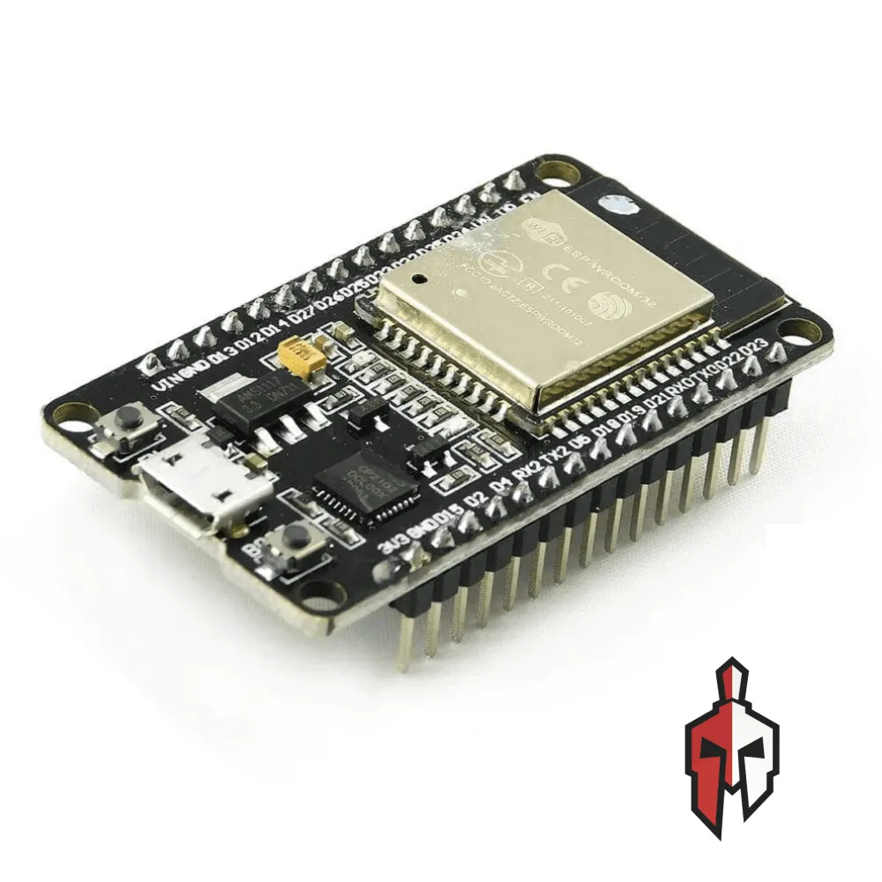
Resources Requirements
Hardware components
Pulse oximeter sensor - Maxim MAX30102
Temperature Sensor - MLX90614
Microcontroller - ESP32
Display Screen - OLED Display
Alarm Components - Miniature Buzzer, RGB LED Lights

Slide 8
SOFTWARE TOOLS
Arduino IDE
ESP32 Board Manager
LIBRARIES FOR SENSOR AND COMPONENTS
ESP32 Libraries
Adafruit MAX3010x Library
Adafruit MLX90614 Library
Adafruit GFX Library

Slide 9

THANKYOU

